Slide 1
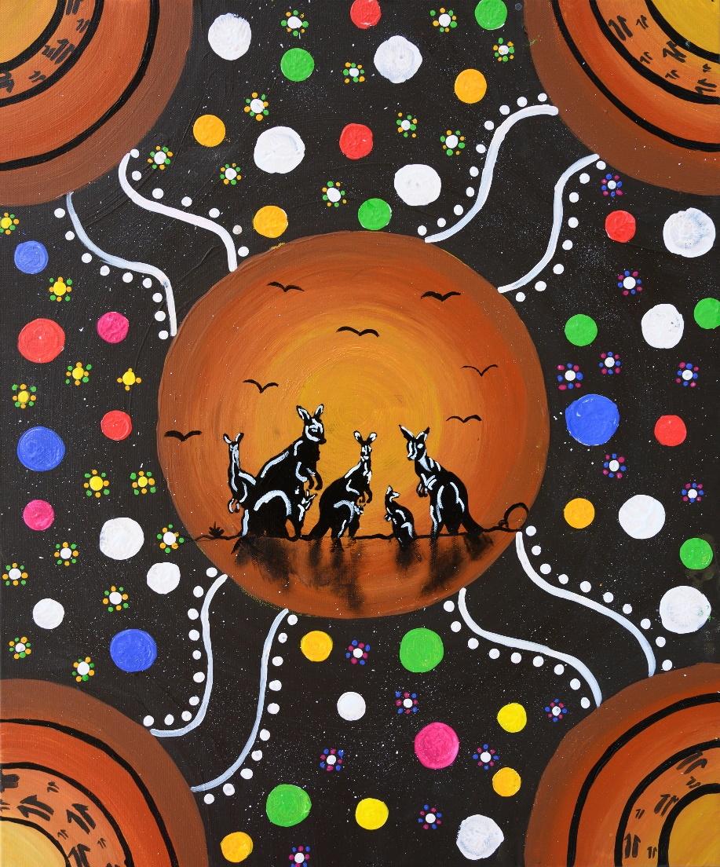
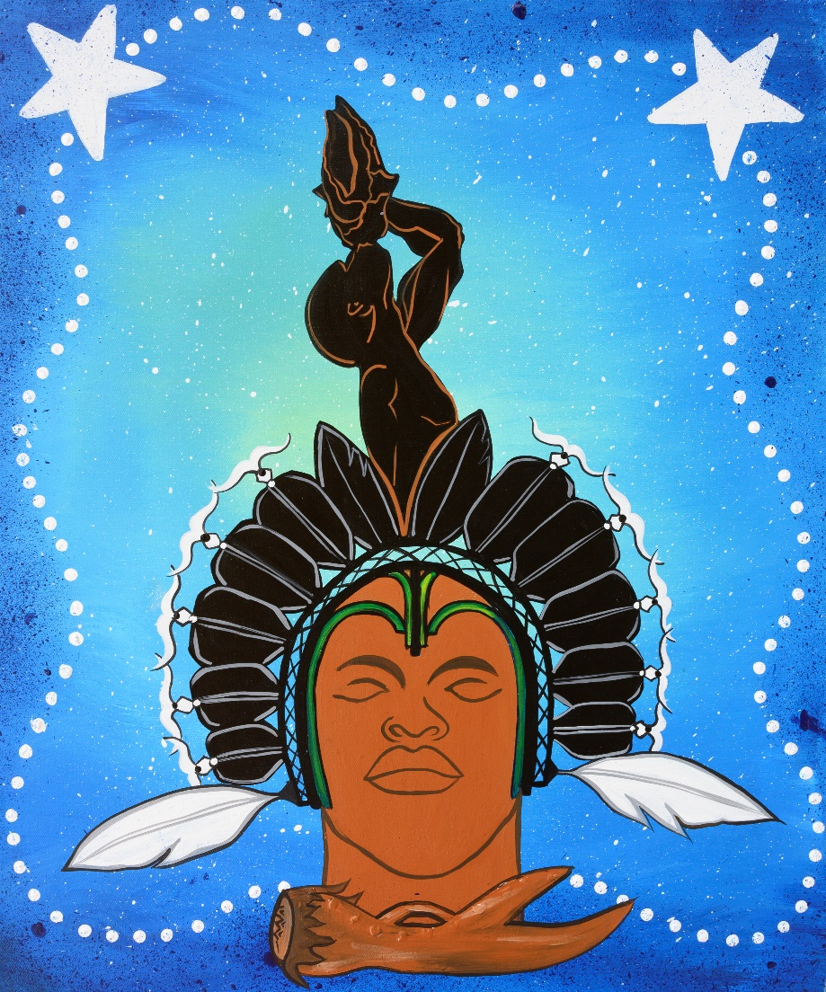
Our values
Respect
Culture
Safety and wellbeing
Adaptability
Collaboration and support
Integrity
Continuous improvement and effectiveness
Youth Justice Framework for Practice:
Our way of working
Logo (something like our directorate)
We respect, value and support diverse cultures and experiences.
Logo (something like our directorate)
Our purpose
The role of Youth Justice in Queensland is to keep the community safe by supporting:
the courts and community in holding young people accountable (we do this by ensuring the young people understand and fulfil the legislative requirements and engage in intervention that addresses their offending behaviours and criminogenic needs)
positive behaviour change in young people by developing skills, restoring family, community, employment, educational and cultural connections that drive reduced reoffending.
Our scope
Young people at risk of offending and young people engaged in the justice system, their families, their communities and their victims.
Linking our values and principles
Our values guide us in all aspects of our work.
Our principles are how we put our values, skills and knowledge bases in action.
We respect, value and support Aboriginal and Torres Strait Islander knowledge, beliefs and perspectives.
Logo (something like our directorate)
We are informed by evidence in our service design and delivery.
Logo (something like our directorate)
We connect young people with their communities and ensure they receive a continuity of service.
Our principles
Logo (something like our directorate)
We value positive, fair and strong leadership that empowers staff.
Logo (something like our directorate)
We actively recruit, support, develop and sustain the best possible people, ensuring a culturally diverse workforce.
Logo (something like our directorate)
We engage and collaborate with key people, working with each young person, in a coordinated way.
Logo (something like our directorate)
We administer our services in a way that is procedurally fair and we keep the information we collect safe.
Logo (something like our directorate)
We provide services within a safe environment and take action to prevent harm, including to young people and victims.
Our skills
Communication
Problem solving
Cultural awareness and capability
Engagement
Reflective practice
Teamwork
Knowledge bases
Partner and community experiences and perspectives
Cultural intelligence, experiences and perspectives
Young person and family experiences and perspectives
Research, evidence, data and systems
Practice insight

